Slide 1
Chapter 10
The Shapes of Molecules

Slide 2
The Shapes of Molecules
10.1 Depicting Molecules and Ions with Lewis Structures
10.2 Valence-Shell Electron-Pair Repulsion (VSEPR) Theory
10.3 Molecular Shape and Molecular Polarity

Slide 3
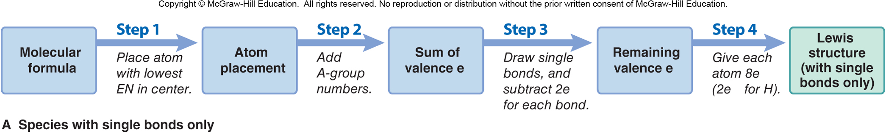
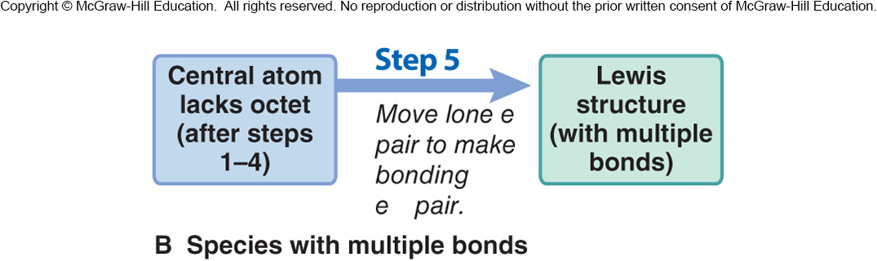
Figure 10.1
The steps in converting a molecular formula into a Lewis structure.

Slide 4
Example: NF₃
Molecular Formula
N has a lower EN than F, so N is placed in the center.
Atom placement
1 x N = 1 x 5 = 5e–
3 x F = 3 x 7 = 21 e–
Total = 26 e–
Sum of valence e–
Remaining valence e–
Lewis structure

Slide 5
Sample Problem 10.1
Writing Lewis Structures for Species with One Central Atom
PROBLEM:
Write a Lewis structure for (a) CCl₂F₂; and (b) PCl₂–.
SOLUTION:
(a) CCl₂F₂
Step 1: Place the atoms relative to each other. Carbon has the lowest EN and is the central atom. The other atoms are placed around it.
Step 2: [1 x C(4e–)] + [2 x F(7e–)] + [2 x Cl(7e–)] = 32 valence e–
Steps 3-4: Add single bonds, then give each atom a full octet.
CHECK: Confirm that each atom has an octet and your Lewis structure accounts for 32 valence electrons.

Slide 6
Sample Problem 10.1
(b) PCl₂–
Step 1: Place atoms relative to each other. Phosphorus has the lower EN and is the central atom. The other atoms are placed around it.
Cl
P
Cl
Step 2: [1 x P(5e–)] + [2 x Cl(7e–)] + [1 negative charge (1e–)] = 20 valence e–
:
:
:
Steps 3-4: Add single bonds, then give each atom a full octet.
:
Cl
P
Cl
:
:
:
:
Step 5: Since PCl₂– is an ion, draw square brackets as shown and add the negative sign at the top (outside the brackets).
CHECK: Confirm that all atoms have octets and your Lewis structure
accounts for 20 valence electrons.

Slide 7
Sample Problem 10.2
Writing Lewis Structures for Molecules with More than One Central Atom
PROBLEM:
Write the Lewis structure for methanol (molecular formula CH₄O), an important industrial alcohol that is being used as a gasoline alternative in car engines.
SOLUTION:
Step 1: Place the atoms relative to each other. H can only form one bond, so C and O must be central and adjacent to each other.
Step 2: [1 x C(4e–)] + [1 x O(6e–)] + [4 x H(1e–)] = 14 valence e–
Step 3-4: Add single bonds, then give each atom (other than H) a full octet.

Slide 8
Multiple Bonds
If there are not enough electrons for the central atom to attain an octet, a multiple bond is present.
Step 5: If the central atom does not have a full octet, change a lone pair on a surrounding atom into another bonding pair to the central atom, thus forming a multiple bond.

Slide 9
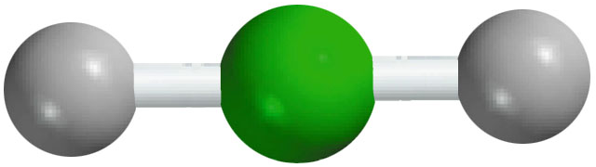
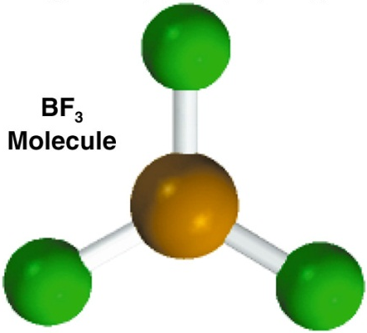
Exceptions to the Octet Rule
The Incomplete Octet
Be – 2e⁻
BeH₂
2H – 2x1e⁻
H
Be
H
4e⁻
B – 3e⁻
3 single bonds (3x2) = 6
F
B
F
BF₃
3F – 3x7e⁻
9 lone pairs (9x2) = 18
24e⁻
Total = 24
F
9.9

Slide 10
Exceptions to the Octet Rule
Odd-Electron Molecules
N – 5e⁻
NO
O – 6e⁻
N
O
11e⁻
The Expanded Octet (central atom with principal quantum number n > 2)
F
F
F
S – 6e⁻
6 single bonds (6x2) = 12
SF₆
6F – 42e⁻
S
18 lone pairs (18x2) = 36
48e⁻
Total = 48
F
F
F
9.9

Slide 11
Sample Problem 10.3
Writing Lewis Structures for Molecules with Multiple Bonds
PROBLEM:
Write Lewis structures for the following:
(a) Ethylene (C₂H₄), the most important reactant in the manufacture of polymers
(b) Nitrogen (N₂), the most abundant atmospheric gas
PLAN:
After following steps 1 to 4 we see that the central atom does not have a full octet. We must therefore add step 5, which involves changing a lone pair to a bonding pair.
SOLUTION:
(a) C₂H₄ has 2(4) + 4(1) = 12 valence e–. H can have only one bond per atom.

Slide 12
Sample Problem 10.3
(b) N₂ has 2(5) = 10 valence e–.
Notes:
12

Slide 13
Resonance Structures
O₃ can be drawn in 2 ways:
These are two different reasonable Lewis structures for the same molecule.
Neither structure depicts O₃ accurately, because in reality the O-O bonds are identical in length and energy.

Slide 14
Resonance Structures
The structure of O₃ is shown more correctly using both Lewis structures, called resonance structures.
A two-headed resonance arrow is placed between them.
Resonance structures have the same relative placement of atoms but different locations of bonding and lone electron pairs.

Slide 15
The Resonance Hybrid
A species like O₃, which can be depicted by more than one valid Lewis structure, is best represented as a resonance hybrid.
Resonance forms are not real bonding depictions.
O₃ does not change back and forth between its two resonance forms.
The real structure of the resonance hybrid for O₃ is an average of its contributing resonance forms.

Slide 16
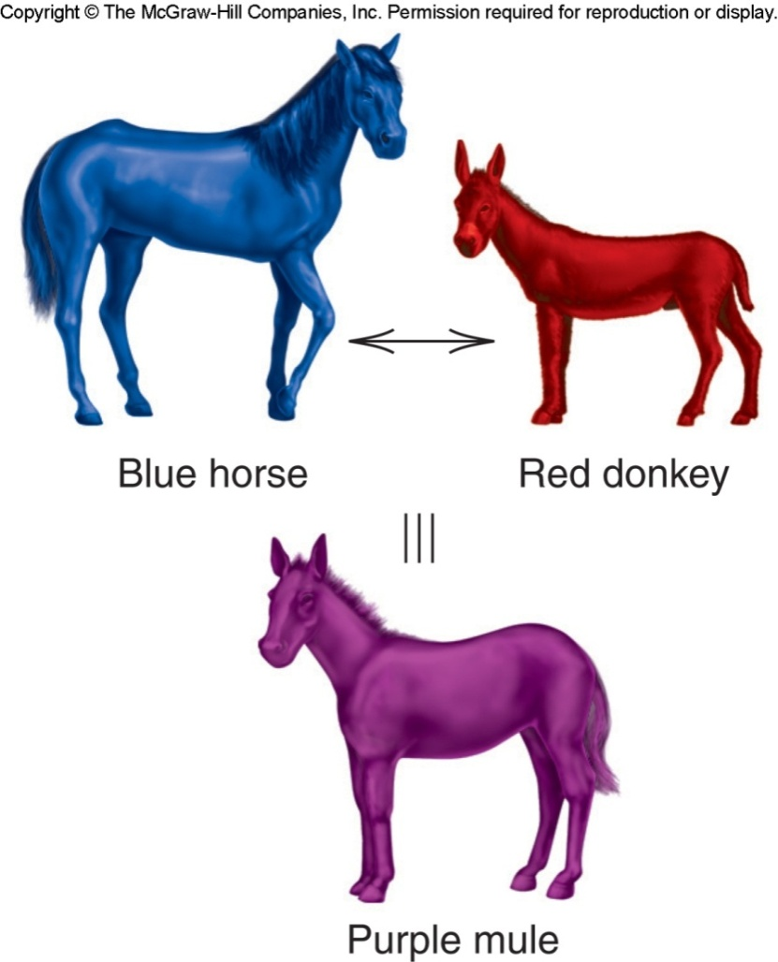
A mule is a genetic mix, a hybrid, of a horse and a donkey. It is not a horse one instant and a donkey the next. Likewise, a resonance hybrid has a single structure although it retains characteristics of its resonance forms.

Slide 17
Electron Delocalization
Lewis structures depict electrons as localized either on an individual atom (lone pairs) or in a bond between two atoms (shared pair).
In a resonance hybrid, electrons are delocalized: their density is “spread” over a few adjacent atoms.

Slide 18
Fractional Bond Orders
Resonance structures often have fractional bond orders due to partial bonding.
3 electron pairs
2 bonded-atom pairs
For O₃, bond order =
= 1½

Slide 19
Sample Problem 10.4
Writing Resonance Structures
PROBLEM:
Write resonance structures for the nitrate ion, NO₃⁻, and find the bond order.
PLAN:
Write the Lewis structure, remembering to add 1e⁻ to the total number of valence e⁻ for the -1 charge. We apply Step 5 to form multiple bonds. Since multiple bonds can be formed in more than one location, there are resonance forms.
SOLUTION:
Nitrate has [1 x N(5e–)] + [3 x O(6e–)] + 1e–] = 24 valence e–
After Steps 1-4:

Slide 20
Sample Problem 10.4
Step 5. Since N does not have a full octet, we change a lone pair from O to a bonding pair to form a double bond.
4 shared electron pairs
3 bonded-atom pairs
Bond order =
= 1⅓
Notes:
20

Slide 21
Formal Charge
Formal charge is the charge an atom would have if all electrons were shared equally.
Formal charge of atom =
# of valence e– - (# of unshared valence e– + ½ # of shared valence e–)
For O_{A} in resonance form I, the formal charge is given by
6 valence e– - (4 unshared e– + ½(4 shared e–) = 6 – 4 – 2 = 0

Slide 22
Formal Charge
Formal charges must sum to the actual charge on the species for all resonance forms.
O_{A} [6 – 4 – ½(4)] = 0
O_{B} [6 – 2 – ½(6)] = +1
O_{C} [6 – 6 – ½(2)] = –1
O_{A} [6 – 6 – ½(2)] = –1
O_{B} [6 – 2 – ½(6)] = +1
O_{C} [6 – 4 – ½(4)] = 0
For both these resonance forms the formal charges sum to zero, since O₃ is a neutral molecule.

Slide 23
Choosing the More Important Resonance Form
Smaller formal charges (positive or negative) are preferable to larger ones.
The same nonzero formal charges on adjacent atoms are not preferred.
Avoid like charges on adjacent atoms.
A more negative formal charge should reside on a more electronegative atom.

Slide 24
An atom’s formal charge is the difference between the number of valence electrons in an isolated atom and the number of electrons assigned to that atom in a Lewis structure.
formal charge on an atom in a Lewis structure
total number of valence electrons in the free atom
total number of nonbonding electrons
(
total number of bonding electrons
1
)
=
-
-
2
The sum of the formal charges of the atoms in a molecule or ion must equal the charge on the molecule or ion.
9.7

Slide 25
Example: NCO⁻ has 3 possible resonance forms:
–2
0
+1
–1
0
0
0
0
–1
Resonance forms with smaller formal charges are preferred. Resonance form I is therefore not an important contributor.
A negative formal charge should be placed on a more electronegative atom, so resonance form III is preferred to resonance form II.
The overall structure of the NCO– ion is a weighted average of all three forms; resonance forms II and III contribute more than I, and III contributes more than II.

Slide 26
Formal Charge Versus Oxidation Number
For a formal charge, bonding electrons are shared equally by the atoms.
The formal charge of an atom may change between resonance forms.
Formal charges
–2
0
+1
–1
0
0
0
0
–1
-3
+4
-2
-3
+4
-2
-3
+4
-2
Oxidation numbers
For an oxidation number, bonding electrons are transferred to the more electronegative atom.
The oxidation number of an atom is the same in all resonance forms.

Slide 27
Exceptions to the Octet Rule
Molecules with Electron-Deficient Atoms
B and Be are commonly electron-deficient.
Odd-Electron Species
A molecule with an odd number of electrons is called a free radical.

Slide 28
Exceptions to the Octet Rule
Expanded Valence Shells
An expanded valence shell is only possible for nonmetals from Period 3 or higher because these elements have available d orbitals.

Slide 29
Sample Problem 10.5
Writing Lewis Structures for Octet-Rule Exceptions
PROBLEM:
Write a Lewis structure and identify the octet-rule exception for (a) SClF₅; (b) H₃PO₄ (draw two resonance forms and select the more important); (c) BFCl₂.
PLAN:
Draw each Lewis structure and examine it for exceptions to the octet rule. Period 3 elements can have an expanded octet, while B commonly forms electron-deficient species.
SOLUTION:
(a) The central atom is S, which is in Period 3 and can have an expanded valence shell.

Slide 30
Sample Problem 10.5
(b) H₃PO₄ has two resonance forms and formal charges indicate the more important form.
(c) BFCl₂ is an electron-deficient molecule. B has only six electrons surrounding it.

Slide 31
Valence-Shell Electron-Pair Repulsion Theory
(VSEPR)
Each group of valence electrons around a central atom is located as far as possible from the others, to minimize repulsions.
A “group” of electrons is any number of electrons that occupies a localized region around an atom.
A single bond, double bond, triple bond, lone pair, or single electron all count as a single group.

Slide 32
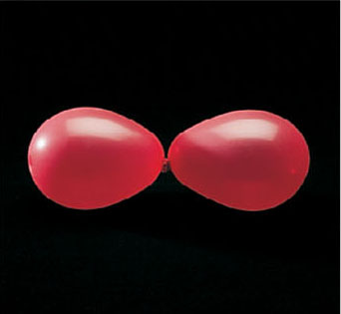
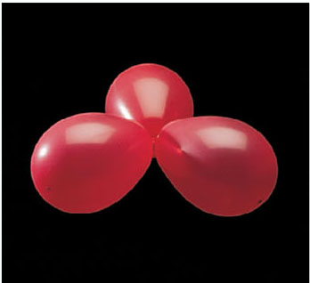
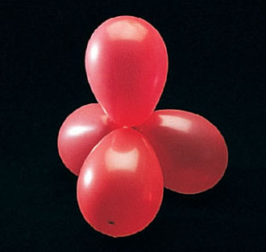
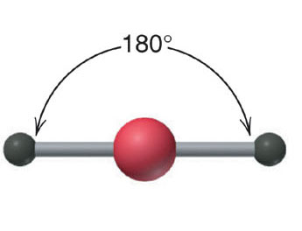
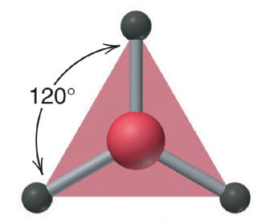
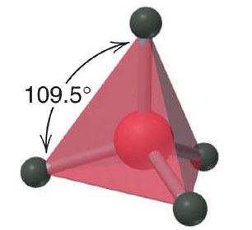
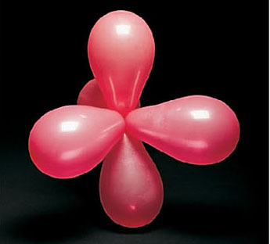
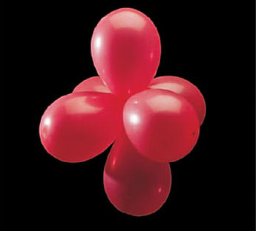
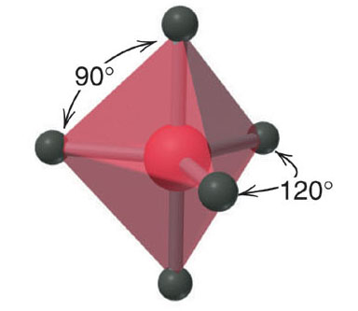
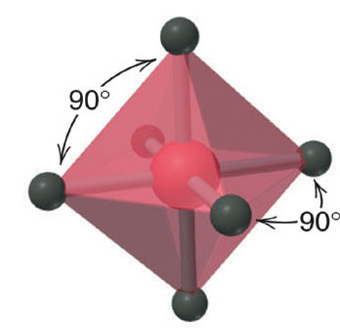
Figure 10.2
Electron-group repulsions and molecular shapes.
linear
trigonal planar
tetrahedral
trigonal bipyramidal
octahedral

Slide 33
Electron-group Arrangement vs Molecular Shape
The electron-group arrangement is defined by both bonding and nonbonding electron groups.
The molecular shape is the three-dimensional arrangement of nuclei joined by the bonding groups. This is defined only by the relative positions of the nuclei.
Molecular shape is classified using the designation
A = central atom
X = surrounding atom
E = nonbonding valence-electron group
m and n are integers
AX_{m}E_{n}

Slide 34
Bond Angle
The bond angle is the angle formed by the nuclei of two surrounding atoms with the nucleus of the central atom.
The angles shown in Figure 10.2 are ideal bond angles, determined by basic geometry alone. Real bond angles deviate from the ideal value in many cases.
X
Y
Z
A
A
A
:
A
X
X
X
X
X
X
X
X
real = ideal
real ≠ ideal
real ≠ ideal
real ≠ ideal

Slide 35
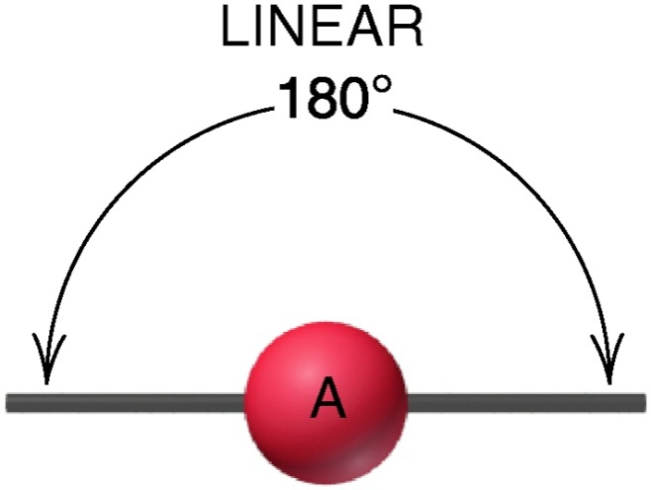
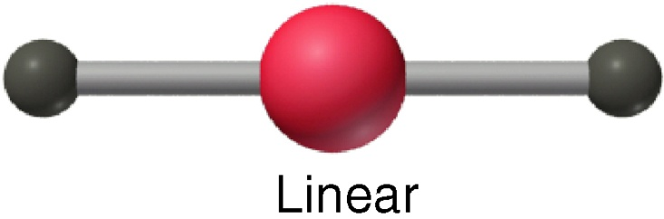
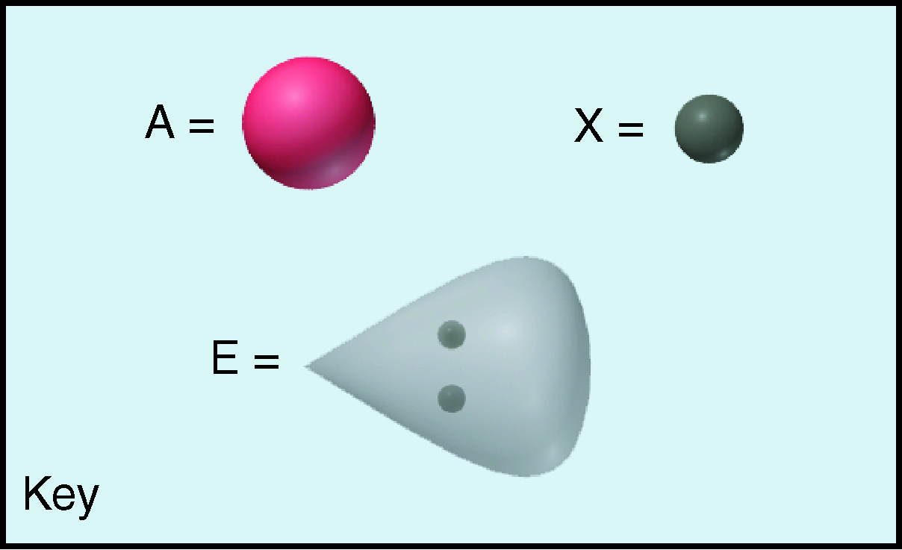
Figure 10.3
The single molecular shape of the linear electron-group arrangement.
Copyright © The McGraw-Hill Companies, Inc. Permission required for reproduction or display.
AX₂
Examples:
CS₂, HCN, BeF₂
This key refers to Figures 10.3 through 10.8.

Slide 36
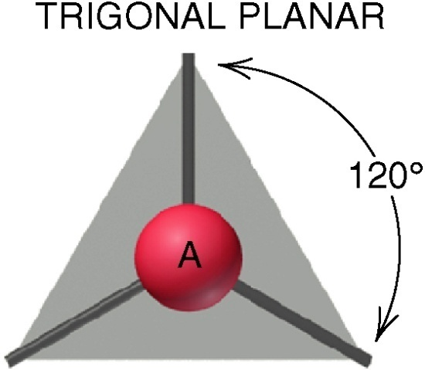
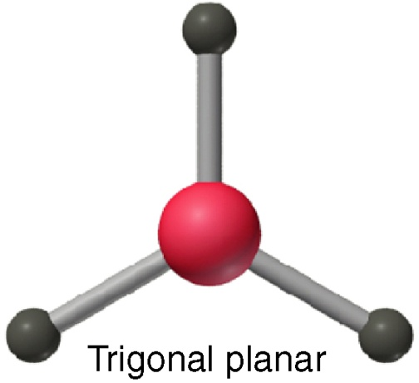
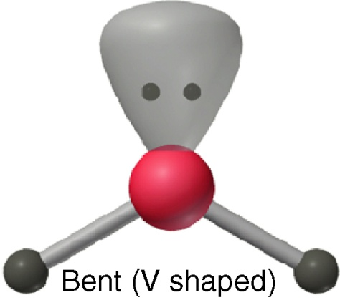
Figure 10.4
The two molecular shapes of the trigonal planar electron-group arrangement.
Copyright © The McGraw-Hill Companies, Inc. Permission required for reproduction or display.
AX₃
Examples:
SO₃, BF₃, NO₃–, CO₃^{2–}
AX₂E
Examples:
SO₂, O₃, PbCl₂, SnBr₂

Slide 37
Factors Affecting Bond Angles
Nonbonding (Lone) Pairs
A lone pair repels bonding pairs more strongly than bonding pairs repel each other. This decreases the angle between the bonding pairs.
Double Bonds
A double bond has greater electron density than a single bond, and repels the single bond electrons more than they repel each other.

Slide 38
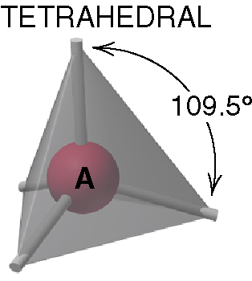
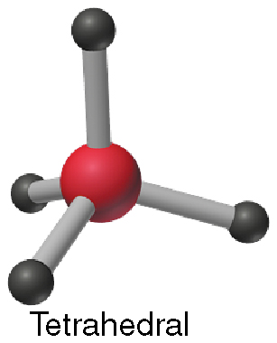
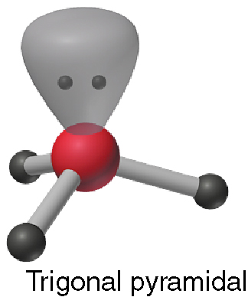
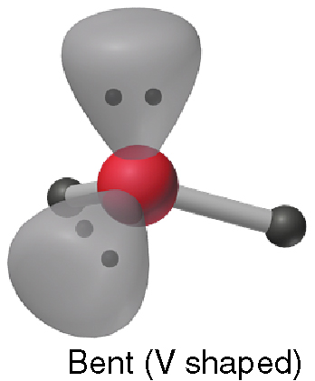
Figure 10.5
The three molecular shapes of the tetrahedral electron-group arrangement.
Copyright © The McGraw-Hill Companies, Inc. Permission required for reproduction or display.
AX₄
Examples:
CH₄, SiCl₄, SO₄^{2–}, ClO₄–
AX₃E
AX₂E₂
Examples:
NH₃, PF₃
ClO₃–, H₃O⁺
Examples:
H₂O, OF₂, SCl₂

Slide 39
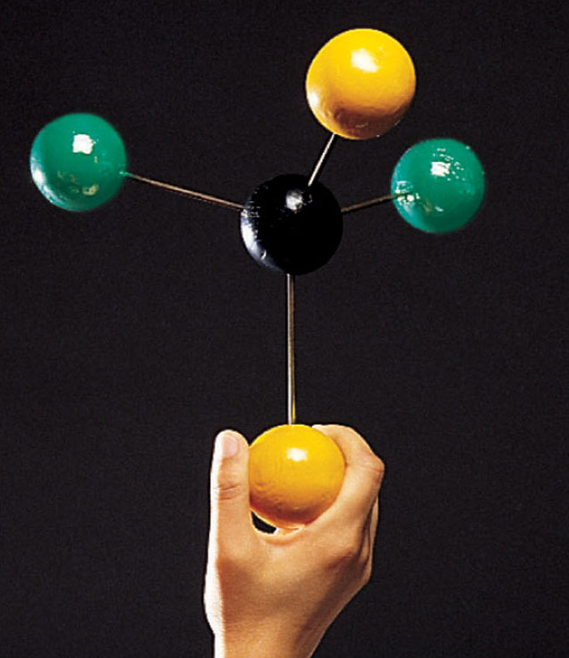
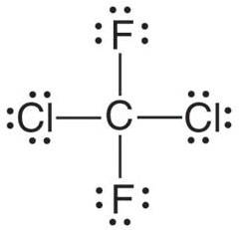
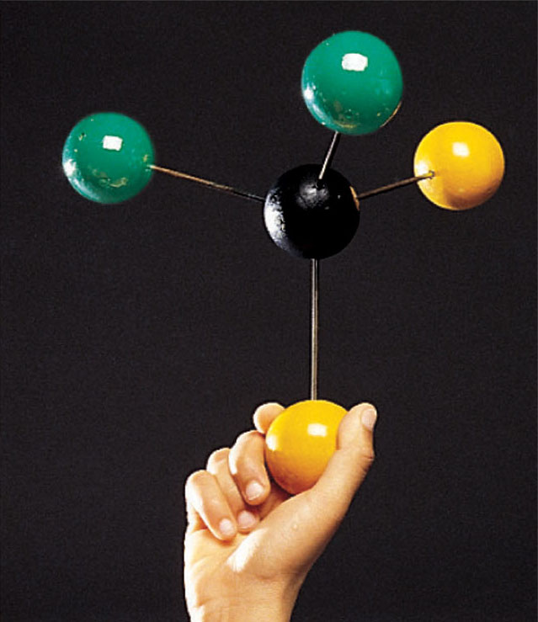

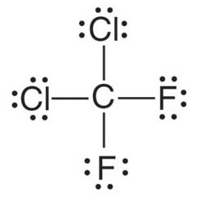
Figure 10.6
Lewis structures do not indicate molecular shape.
twist to the right
twist to the left

Slide 40
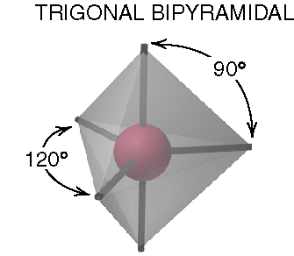
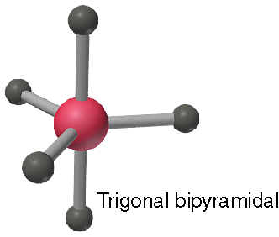
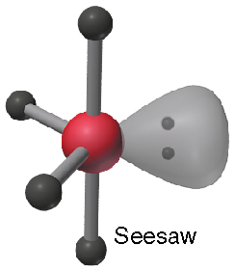
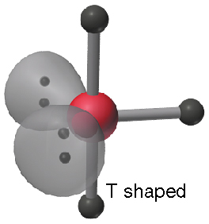
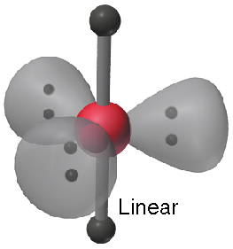
Figure 10.7
The four molecular shapes of the trigonal bipyramidal electron-group arrangement.
Copyright © The McGraw-Hill Companies, Inc. Permission required for reproduction or display.
AX₅
Examples:
PF₅, AsF₅,
SOF₄
AX₄E
Examples:
SF₄, XeO₂F₂
IF₄⁺, IO₂F₂–
AX₃E₂
AX₂E₃
Examples:
ClF₃, BrF₃
Examples:
XeF₂, I₃–, IF₂–

Slide 41
Axial and Equatorial Positions
A five electron-group system has two different positions for electron groups, and two ideal bond angles.
Equatorial-equatorial repulsions are weaker than axial-equatorial repulsions.
Where possible, lone pairs in a five electron-group system occupy equatorial positions.

Slide 42
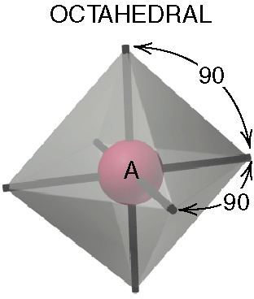
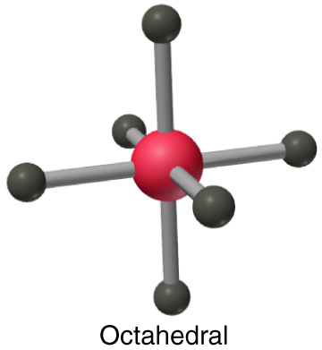
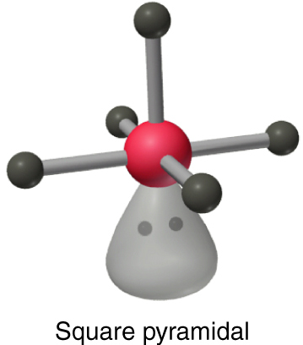
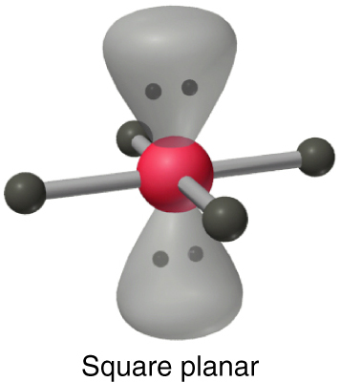
Figure 10.8
The three molecular shapes of the octahedral electron-group arrangement.
AX₆
Examples:
SF₆, IOF₅
AX₅E
AX₄E₂
Examples:
BrF₅, TeF₅–,
XeOF₄
Examples:
XeF₄, ICl₄–

Slide 43
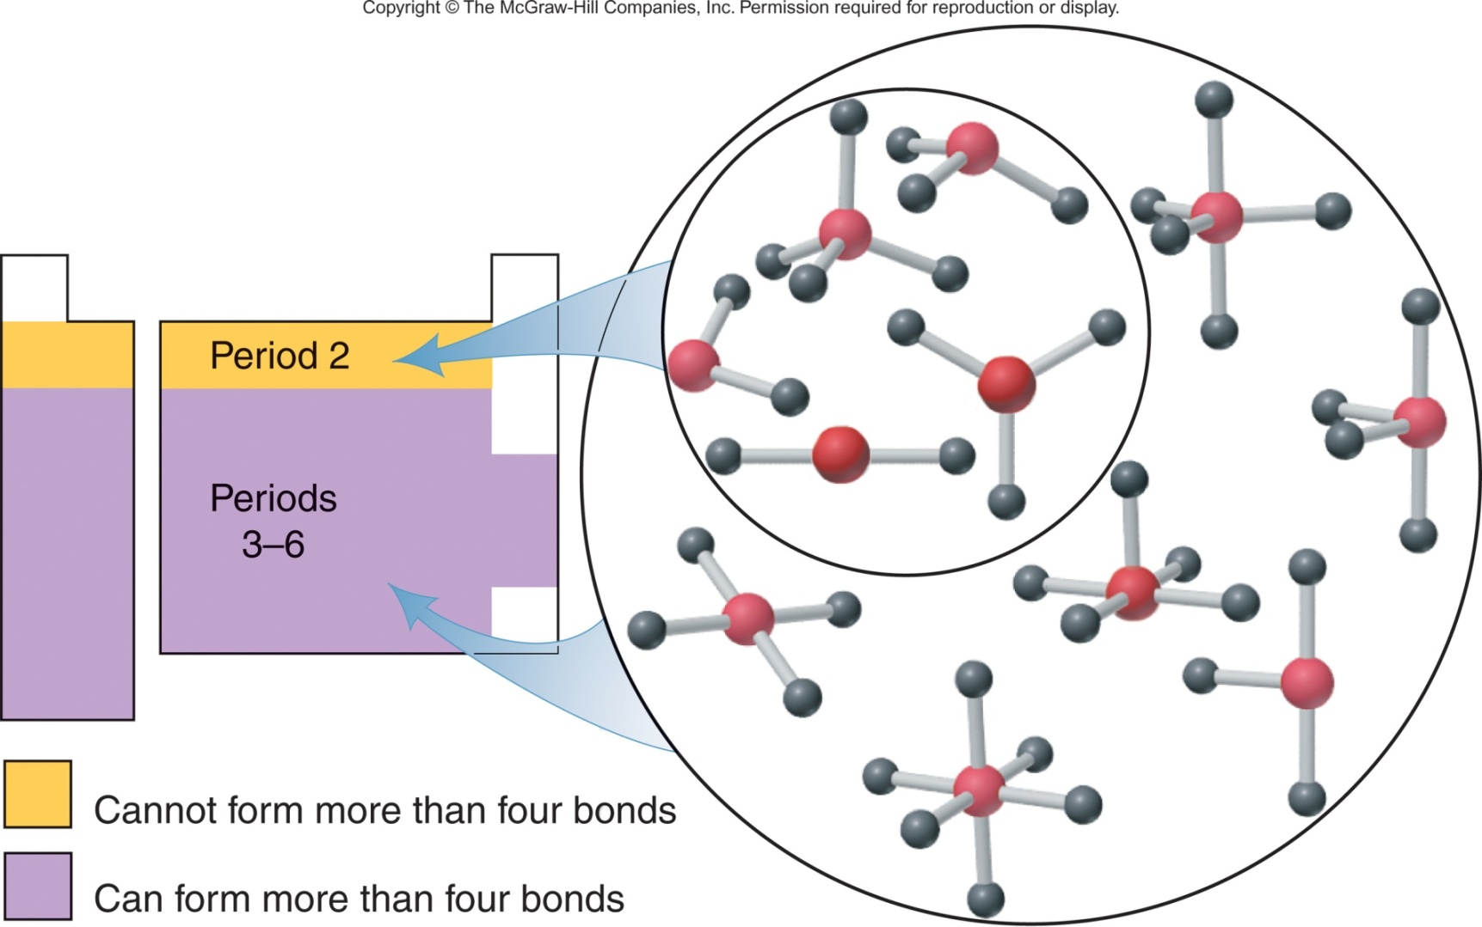
Figure 10.9
Molecular shapes for central atoms in Period 2 and in higher periods.

Slide 44
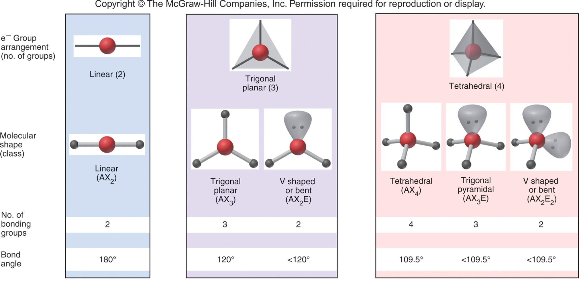
Figure 10.10
A summary of common molecular shapes with two to six electron groups.

Slide 45
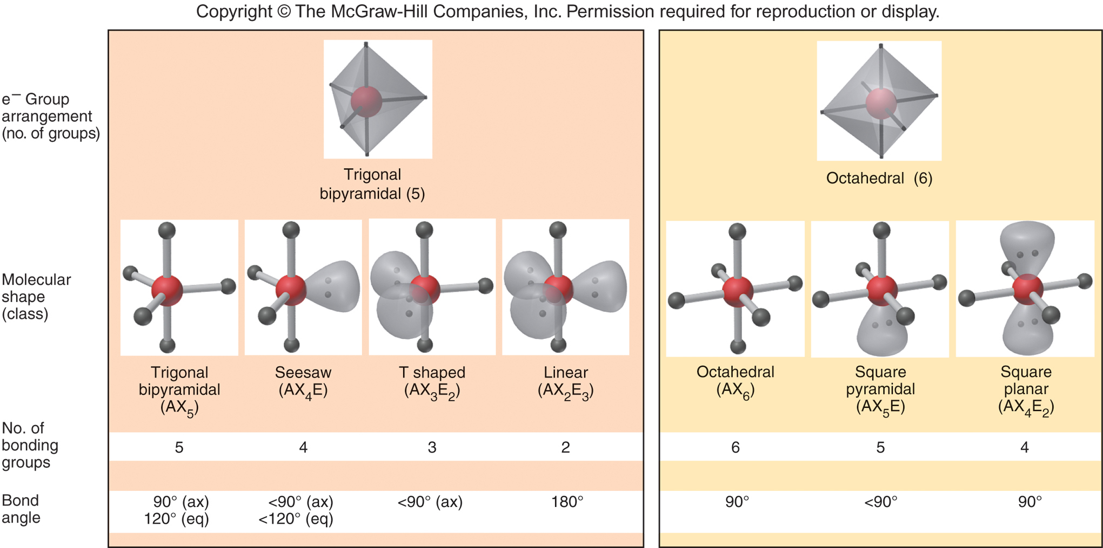
Figure 10.10 continued

Slide 46
Figure 10.11
The four steps in converting a molecular formula to a molecular shape
Molecular Formula
Step 1
Draw Lewis structure.
Lewis structure
Step 2
Count all e⁻ groups around central atom (A).
Electron-group arrangement
Step 3
Note positions of any lone pairs and double bonds.
Step 4
Count bonding and nonbonding e⁻ groups separately.
Bond angles
Molecular shape
(AX_{m}E_{n})

Slide 47
The Shapes of Molecules
The shape of a 2-atom compound is always linear.
With 3 or more atoms, the geometries (bond angles) are determined by analyzing...
- How many regions of electron density ……central atoms have, and
- How many of those regions are occupied ……in bonds

Slide 48

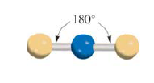
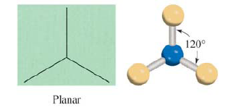
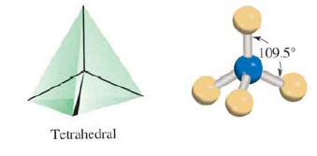
Molecules in which the central atom has no lone pairs Beryllium Chloride
Boron Trifluoride Methane

Slide 49
Hybridization- mixing of two or more atomic orbitals to form a new set of hybrid orbitals
Mix at least 2 nonequivalent atomic orbitals (e.g. s and p.). Hybrid orbitals have very different shape from original atomic orbitals.
Number of hybrid orbitals is equal to number of pure atomic orbitals used in the hybridization process.
Covalent bonds are formed by
Overlap of hybrid orbitals with atomic orbitals.
Overlap of hybrid orbitals with other hybrid orbitals.

Slide 50
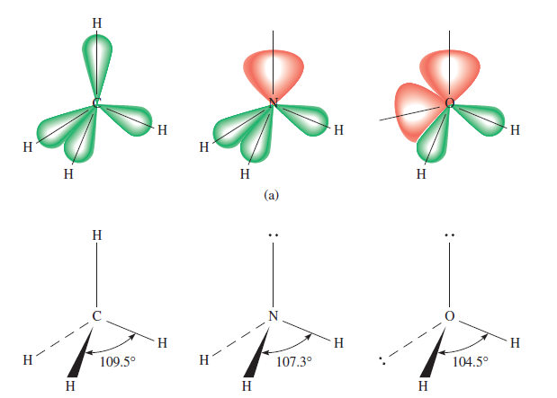
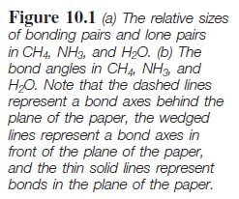

Slide 51
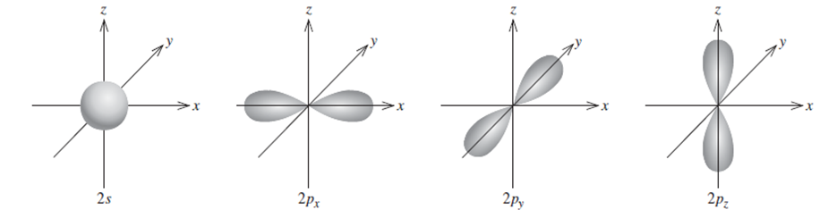
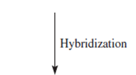
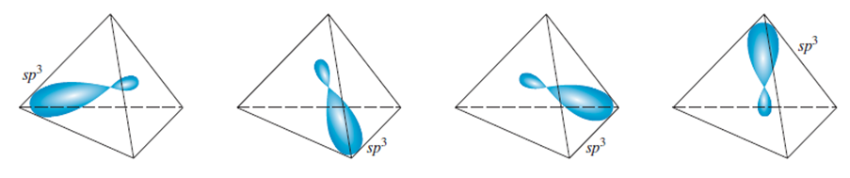
Formation of sp³ Hybrid Orbitals

Slide 52
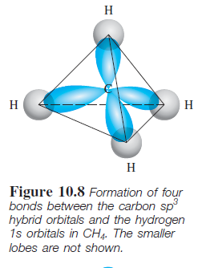
Formation of Covalent bonds in CH₄

Slide 53

sp³ Hybridizes N atom in NH₃

Slide 54

Formation of sp² Hybrid Orbitals

Slide 55

Formation of sp Hybrid Orbitals

Slide 56


Slide 57

sp² hybridization of carbon

Slide 58


Slide 59

Bonding of ethylene, C₂H₄
Sigma bond (σ): electron density between 2 atoms.
Pi bond (π): electron density above and below plane of nuclei of the bonding atoms.

Slide 60

Another view of π bonding in ethylene, C₂H₄

Slide 61

sp hybridization of carbon

Slide 62

Bonding of Acetylene, C₂H₂

Slide 63

Another view of the Bonding of Acetylene, C₂H₂

Slide 64
Sigma (σ) and Pi Bonds (π)
Single bond 1 sigma bond
Double bond 1 sigma bond and 1 Pi bond
Triple bond 1 sigma bond and 2 Pi bonds
How many sigma and Pi bonds are there in the acetic acid (Vinegar) molecule CH₃COOH?

Slide 65


Delocalized molecular orbitals are not confined between two adjacent bonding atoms, but actually extend over three or more atoms.
Delocalized πorbital

Slide 66

Electron density above and below the plane of the benzene molecule

Slide 67

Bonding in the Carbonate ion CO₃²⁻

Slide 68
The VSEPR Model
Geometries can be predicted from the Valence Shell Electron Pair Repulsion model (VSEPR)
It places regions of electron density as far apart as possible

Slide 69
3 Steps to VSEPR Shape
1. Draw a Lewis structure
2. Count regions of e⁻ density around.central atom
Triple bond = 1 region
Double bond = 1 region
Single bond = 1 region
Lone pair = 1 region
3. Count the number of regions with bonds ….around atom

Slide 70
# of regions # with bonds Shape
2 2 Linear
3 2 Bent
3 Trigonal planar
4 2 Bent
3 Triangular pyramid
4 Tetrahedral

Slide 71
# of regions # with bonds Shape
5 2 Linear
3 T-shaped
4 See Saw
5 Triangular bipyramid
6 2 Linear
3 T-shaped
4 Square planar
5 Square pyramid
6 Octahedral

Slide 72
Example 1: Laughing Gas
N
N
O
How many regions of electron density?

Slide 73
Example 1: Laughing Gas
Atom of interest
N
N
O
How many regions of electron density?

Slide 74
Example 1: Laughing Gas
1
N
N
O
How many regions of electron density?

Slide 75
Example 1: Laughing Gas
1
2
N
N
O
How many regions of electron density?

Slide 76
Example 1: Laughing Gas
Ignore! Not around central atom of interest!
1
2
N
N
O
So we have 2 regions

Slide 77
Example 1: Laughing Gas
1
2
N
N
O
So we have 2 regions

Slide 78
Example 1: Laughing Gas
1
2
N
N
O
How many regions are bonds?

Slide 79
Example 1: Laughing Gas
1
2
N
N
O
1
How many regions are bonds?

Slide 80
Example 1: Laughing Gas
1
2
N
N
O
1
2
How many regions are bonds?

Slide 81
Example 1: Laughing Gas
1
2
N
N
O
1
2
So we have 2 regions with 2 bonds

Slide 82
# of regions # with bonds Shape
2 2 Linear
3 2 Bent
3 Trigonal planar
4 2 Bent
3 Triangular pyramid
4 Tetrahedral

Slide 83
# of regions # with bonds Shape
2 2 Linear
3 2 Bent
3 Trigonal planar
4 2 Bent
3 Triangular pyramid
4 Tetrahedral

Slide 84
# of regions # with bonds Shape
2 2 Linear
3 2 Bent
3 Trigonal planar
4 2 Bent
3 Triangular pyramid
4 Tetrahedral

Slide 85
# of regions # with bonds Shape
2 2 Linear
3 2 Bent
3 Trigonal planar
4 2 Bent
3 Triangular pyramid
4 Tetrahedral

Slide 86
Example 2: Carbonate Ion
1. Find total # of valence e-’s in molecule or ion
1 x C = 1 x 4e⁻ = 4 e⁻
3 x O = 3 x 6e⁻ = 18 e⁻
species charge = 2 e⁻
______________________________
Total 24 e⁻

Slide 87
Example 2: Carbonate Ion
2. Connect the skeleton with single bonds
O
O
C
O
24 e⁻

Slide 88
Example 2: Carbonate Ion
2. Connect the skeleton with single bonds
3. Place lone pairs to give non-H terminal atoms an octet
O
O
C
O
24 e⁻

Slide 89
Example 2: Carbonate Ion
2. Connect the skeleton with single bonds
3a. Check to see how many e⁻’s are left and all octets
O
O
C
O
24 e⁻’s used, octet NOT okay
24 e⁻

Slide 90
Example 2: Carbonate Ion
2. Connect the skeleton with single bonds
3a. Check to see how many e⁻’s are left and all octets
O
O
C
O
Uh-oh! We’re short e⁻’s!
24 e⁻

Slide 91
Example 2: Carbonate Ion
If short e⁻’s, go to 5
O
O
C
O
Uh-oh! We’re short e⁻’s!
24 e⁻

Slide 92
Example 2: Carbonate Ion
5. If short e-’s, look for multiple bonders or e⁻ deficients
O
O
C
O
Uh-oh! We’re short e⁻’s!
24 e⁻

Slide 93
Example 2: Carbonate Ion
5. If short e-’s, look for multiple bonders or e⁻ deficients
O
O
C
O
We’re short 2 e⁻’s, so need 1 multiple bond
24 e⁻

Slide 94
Example 2: Carbonate Ion
5. If short e-’s, look for multiple bonders or e⁻ deficients
O
O
C
O
Move a lone pair into a shared position
24 e⁻

Slide 95
Example 2: Carbonate Ion
5. If short e-’s, look for multiple bonders or e⁻ deficients
O
O
C
O
Octet full, 24 e⁻’s preserved
24 e⁻

Slide 96
Example 2: Carbonate Ion
O
O
C
O
We’re almost done...
24 e⁻

Slide 97
Example 2: Carbonate Ion
2-
O
O
C
O
24 e⁻

Slide 98
Example 2: Carbonate Ion
2-
O
O
C
O
Now for its shape
24 e⁻

Slide 99
Example 2: Carbonate Ion
2-
O
2
2
O
1
C
3
O
3
1
3 Regions 3 Bonds
24 e⁻

Slide 100
# of regions # with bonds Shape
2 2 Linear
3 2 Bent
3 Trigonal planar
4 2 Bent
3 Triangular pyramid
4 Tetrahedral

Slide 101
Example 2: Carbonate Ion
2-
O
120º
120º
C
O
O
120º
Better drawing!

Slide 102
Resonance structures
O
C
-
-
O
O
-
The real structure is a hybrid of all three
O
-
O
C
-
C
O
O
-
O
O

Slide 103
Example 2: Carbonate Ion
2-
O
C
O
O
Best drawing?

Slide 104

Here’s how we now view each lobe of the π-orbital

Slide 105
Example 2: Carbonate Ion
O
σ
C
O
σ
O
σ
Three σ-orbitals form a triangular plane (seen from slightly above here)

Slide 106
Example 2: Carbonate Ion
O
σ
π⁺
C
O
σ
O
σ
One lobe of the π molecular orbital forms a triangular half-bun on top of the molecule

Slide 107
Example 2: Carbonate Ion
O
π⁺
C
O
O
π⁻
The second lobe of the π molecular orbital forms a triangular half-bun on the bottom of the molecule

Slide 108
Example 2: Carbonate Ion
O
π⁺
C
O
O
π⁻
Essentially, the two π-electrons are free to wander throughout the region of the triangular buns

Slide 109
Example 2: Carbonate Ion
O
π⁺
C
O
O
π⁻
This imparts a special stability to the structure

Slide 110
Example 4: Xenon Tetrafluoride
2. Connect the skeleton with single bonds
F
F
Xe
F
F
36 e⁻

Slide 111
Example 4: Xenon Tetrafluoride
3. Place lone pairs to give non-H terminal atoms an octet
F
F
Xe
F
F
36 e⁻

Slide 112
Example 4: Xenon Tetrafluoride
3. Place lone pairs to give non-H terminal atoms an octet
F
F
Xe
F
F
36 e⁻

Slide 113
Example 4: Xenon Tetrafluoride
3a. Check to see how many e⁻’s are left and all octets
F
F
Xe
F
F
36 e⁻

Slide 114
Example 4: Xenon Tetrafluoride
3a. Check to see how many e⁻’s are left and all octets
F
F
Xe
F
8 e⁻’s
left octet okay
F
36 e⁻

Slide 115
Example 4: Xenon Tetrafluoride
3a. Check to see how many e⁻’s are left and all octets
F
F
Xe
F
8 + 8 = 16 e⁻’s
bottom octet okay
F
36 e⁻

Slide 116
Example 4: Xenon Tetrafluoride
3a. Check to see how many e⁻’s are left and all octets
F
F
Xe
F
F
8 + 16 = 24 e⁻’s
right octet okay
36 e⁻

Slide 117
Example 4: Xenon Tetrafluoride
3a. Check to see how many e⁻’s are left and all octets
F
F
Xe
F
F
8 + 24 = 32 e⁻’s
top octet okay
36 e⁻

Slide 118
Example 4: Xenon Tetrafluoride
3a. Check to see how many e⁻’s are left and all octets
F
0 + 32 = 32 e⁻’s
middle octet okay
F
Xe
F
F
36 e⁻

Slide 119
Example 4: Xenon Tetrafluoride
3a. Check to see how many e⁻’s are left and all octets
F
0 + 32 = 32 e⁻’s
middle octet okay
but...
F
Xe
F
F
36 e⁻

Slide 120
Example 4: Xenon Tetrafluoride
3a. Check to see how many e⁻’s are left and all octets
F
0 + 32 = 32 e⁻’s
I haven’t used
all 36 e⁻’s!
F
Xe
F
F
36 e⁻

Slide 121
Example 4: Xenon Tetrafluoride
If e⁻’s still left, go to 4
F
0 + 32 = 32 e⁻’s
I haven’t used
all 36 e⁻’s!
F
Xe
F
F
36 e⁻

Slide 122
Example 4: Xenon Tetrafluoride
Place remaining e⁻’s on central atom (but check)
F
0 + 32 = 32 e⁻’s
I haven’t used
all 36 e⁻’s!
F
Xe
F
F
36 e⁻

Slide 123
Example 4: Xenon Tetrafluoride
Place remaining e⁻’s on central atom (but check)
F
4 + 32 = 36 e⁻’s
I’ve used
all 36 e⁻’s!
F
Xe
F
F
36 e⁻

Slide 124
Example 4: Xenon Tetrafluoride
Place remaining e⁻’s on central atom (but check)
F
It’s an expanded octet. Okay for Xe.
F
Xe
F
F
36 e⁻

Slide 125
Example 4: Xenon Tetrafluoride
F
F
Xe
F
F
36 e⁻

Slide 126
Example 4: Xenon Tetrafluoride
F
F
Xe
F
F
Now for its shape

Slide 127
How many regions of density in XeF₄?
2
3
4
5
6

Slide 128
How many regions of density in XeF₄?
2
3
4
5
6

Slide 129
Example 4: Xenon Tetrafluoride
F
F
Xe
F
F
Regions

Slide 130
Example 4: Xenon Tetrafluoride
F
F
Xe
F
1
F
1 Region

Slide 131
Example 4: Xenon Tetrafluoride
F
2
F
Xe
F
1
F
2 Regions

Slide 132
Example 4: Xenon Tetrafluoride
F
2
3
F
Xe
F
1
F
3 Regions

Slide 133
Example 4: Xenon Tetrafluoride
F
2
3
F
Xe
4
F
1
F
4 Regions

Slide 134
Example 4: Xenon Tetrafluoride
F
2
3
F
Xe
4
F
1
5
F
5 Regions

Slide 135
Example 4: Xenon Tetrafluoride
F
2
3
F
Xe
4
F
1
6
5
F
6 Regions

Slide 136
Example 4: Xenon Tetrafluoride
F
F
Xe
F
F
6 Regions

Slide 137
Example 4: Xenon Tetrafluoride
F
F
Xe
F
F
6 Regions
Bonds

Slide 138
Example 4: Xenon Tetrafluoride
F
F
Xe
F
1
F
6 Regions
1 Bond

Slide 139
Example 4: Xenon Tetrafluoride
F
F
Xe
F
2
1
F
6 Regions
2 Bonds

Slide 140
Example 4: Xenon Tetrafluoride
F
3
F
Xe
F
2
1
F
6 Regions
3 Bonds

Slide 141
Example 4: Xenon Tetrafluoride
F
3
F
Xe
4
F
2
1
F
6 Regions
4 Bonds

Slide 142
# of regions # with bonds Shape
5 2 Linear
3 T-shaped
4 See Saw
5 Triangular bipyramid
6 2 Linear
3 T-shaped
4 Square planar
5 Square pyramid
6 Octahedral

Slide 143
# of regions # with bonds Shape
5 2 Linear
3 T-shaped
4 See Saw
5 Triangular bipyramid
6 2 Linear
3 T-shaped
4 Square planar
5 Square pyramid
6 Octahedral

Slide 144
# of regions # with bonds Shape
5 2 Linear
3 T-shaped
4 See Saw
5 Triangular bipyramid
6 2 Linear
3 T-shaped
4 Square planar
5 Square pyramid
6 Octahedral

Slide 145
# of regions # with bonds Shape
5 2 Linear
3 T-shaped
4 See Saw
5 Triangular bipyramid
6 2 Linear
3 T-shaped
4 Square planar
5 Square pyramid
6 Octahedral

Slide 146
Example 4: Xenon Tetrafluoride
F
F
F
Xe
Xe
F
F

Slide 147
Sample Problem 10.6
Examining Shapes with Two, Three, or Four Electron Groups
PROBLEM:
Draw the molecular shape and predict the bond angles (relative to the ideal bond angles) of (a) PF₃ and (b) COCl₂.
SOLUTION:
(a) For PF₃, there are 26 valence electrons. The Lewis structure is
There are four electron groups around P, giving a tetrahedral electron-group arrangement. The ideal bond angle is therefore 109.5°.
There is one lone pair and three bonding pairs, so the actual bond angle will be less than 109.5°.

Slide 148
Sample Problem 10.6
The molecular shape for PF₃ is trigonal pyramidal (AX₃E).
Notes:
148

Slide 149
Sample Problem 10.6
(b) For COCl₂ there are 24 valence e⁻. The Lewis structure is
There are three electron groups around C, giving a trigonal planar electron-group arrangement. The ideal bond angle is 120°, but the double bond will compress the Cl-C-Cl angle to less than 120°.

Slide 150

Sample Problem 10.7
Examining Shapes with Five or Six Electron Groups
PROBLEM:
Draw the molecular shapes and predict the bond angles (relative to the ideal bond angles) of (a) SbF₅ and (b) BrF₅.
SOLUTION:
(a) SbF₅ has 40 valence e⁻. The Lewis structure is
There are five electron groups around Sb, giving a trigonal bipyramidal electron-group arrangement. The ideal bond angles are 120° between equatorial groups and 90° between axial groups.
Copyright © The McGraw-Hill Companies, Inc. Permission required for reproduction or display.

Slide 151

Sample Problem 10.7
(b) BrF₅ has 42 valence e⁻. The Lewis structure is
There are six electron groups around Br, giving an octahedral electron-group arrangement. The ideal bond angles are 90°. There is one lone pair, so the bond angles will be less than 90° and the molecular shape is square pyramidal.
Copyright © The McGraw-Hill Companies, Inc. Permission required for reproduction or display.
Notes:
151

Slide 152


Figure 10.12
The tetrahedral shapes around the central atoms and the overall shapes of ethane (A) and ethanol (B).
Copyright © The McGraw-Hill Companies, Inc. Permission required for reproduction or display.
ethane
ethanol
CH₃CH₃
CH₃CH₂OH

Slide 153
Sample Problem 10.8
Predicting Molecular Shapes with More Than One Central Atom
PROBLEM:
Determine the shape around each of the central atoms in acetone, (CH₃)₂CO.
PLAN:
There are three central C atoms, two of which are in CH₃– groups. We determine the shape around one central atom at a time.
SOLUTION:
Step 1: The Lewis structure is
Step 2: Each CH₃– group has four electron groups around its central C, so the electron-group arrangement is tetrahedral. The third C atom has three electron groups around it, with a trigonal planar arrangement.

Slide 154

Sample Problem 10.8
Step 3: The H-C-H bond angle in each CH₃– group should be near the ideal value of 109.5°. The C=O double bond will compress the C-C-C angle to less than the ideal angle of 120°.
Step 4: The shape around the C in each CH₃– group is tetrahedral (AX₄). The shape around the middle C is trigonal planar (AX₃).
Copyright © The McGraw-Hill Companies, Inc. Permission required for reproduction or display.
Notes:
154

Slide 155
Molecular Shape and Molecular Polarity
Overall molecular polarity depends on both shape and bond polarity.
The polarity of a molecule is measured by its dipole moment (μ), which is given in the unit debye (D).
A molecule is polar if
it contains one or more polar bonds and
the individual bond dipoles do not cancel.

Slide 156



Figure 10.13
The orientation of polar molecules in an electric field.
Copyright © The McGraw-Hill Companies, Inc. Permission required for reproduction or display.
Molecules are randomly oriented.
Molecules become oriented when the field is turned on.

Slide 157

Bond Polarity, Bond Angle, and Dipole Moment
Example: CO₂
The ΔEN between C (EN = 2.5) and O (EN = 3.5) makes each C=O bond polar.
Copyright © The McGraw-Hill Companies, Inc. Permission required for reproduction or display.
CO₂ is linear, the bond angle is 180°, and the individual bond polarities therefore cancel. The molecule has no net dipole moment (μ = 0 D).

Slide 158

Bond Polarity, Bond Angle, and Dipole Moment
Example: H₂O
The ΔEN between H (EN = 2.1) and O (EN = 3.5) makes each H-O bond polar.
Copyright © The McGraw-Hill Companies, Inc. Permission required for reproduction or display.
H₂O has a V shaped (bent) geometry and the individual bond polarities do not cancel. This molecule has an overall molecular polarity. The O is partially negative while the H atoms are partially positive.

Slide 159
Bond Polarity, Bond Angle, and Dipole Moment
Molecules with the same shape may have different polarities.
CCl₄
CHCl₃
Bonds are polar, but individual bond polarities cancel.
Bond polarities do not cancel. This molecule is polar (μ = 1.01 D).

Slide 160
Sample Problem 10.9
Predicting the Polarity of Molecules
PROBLEM:
For each of the following use the molecular shape and EN values and trends (Figure 9.21, p. 381) to predict the direction of bond and molecular polarity, if present.
(a) Ammonia, NH₃
(b) Boron trifluoride, BF₃
(c) Carbonyl sulfide, COS (atom sequence SCO)
PLAN:
We draw and name the molecular shape, and mark each polar bond with a polar arrow pointing toward the atom with the higher EN. If bond polarities balance one another, the molecule is nonpolar. If they reinforce each other, we show the direction of overall molecular polarity.

Slide 161
Sample Problem 10.9
SOLUTION:
(a) NH₃ has 8 valence e⁻ and a trigonal pyramidal molecular shape.
N (EN = 3.0) is more electronegative than H (EN = 2.1) so bond polarities point toward N.
Ammonia is polar overall.
Notes:
161

Slide 162
Sample Problem 10.9
(b) BF₃ has 24 valence e⁻ and a trigonal planar molecular shape.
F (EN = 4.0) is more electronegative than B (EN = 2.0) so bond polarities point toward F.
Individual bond polarities balance each other and BF₃ therefore has no overall molecular polarity.
Boron trifluoride is nonpolar.
Notes:
162

Slide 163
Sample Problem 10.9
(c) COS has a linear shape.
C and S have the same EN (2.5) but the C=O bond (ΔEN = 1.0) is quite polar.
Carbonyl sulfide is polar overall.
Notes:
163

Slide 164
The Effect of Molecular Polarity on Behavior
Example: The cis and trans isomers of C₂H₂Cl₂
The cis isomer is polar while the trans isomer is not. The boiling point of the cis isomer is 13ºC higher than that of the trans isomer.

Slide 165

Figure 10.14
The influence of atomic properties on macroscopic behavior.

Slide 166


Experiments show O₂ is paramagnetic
O
O
No unpaired e⁻
Should be diamagnetic
Molecular orbital theory – bonds are formed from interaction of atomic orbitals to form molecular orbitals.
10.6

Slide 167

Limitations of VB Theory
Inadequately explains magnetic/spectral properties
Inadequately treats electron delocalization
VB theory assumes a localized bonding model

Slide 168


Molecular Orbital (MO) Theory
A delocalized bonding model
A quantum-mechanical treatment of molecules
similar to that used for isolated atoms
Invokes the concept of molecular orbitals (MOs)
(extension of atomic orbitals)
Exploits the wave-like properties of matter (electrons)

Slide 169

10.6

Slide 170



An analogy between light waves and atomic wave functions
Amplitudes of wave functions are added
Amplitudes of wave functions are subtracted

Slide 171
Central themes of molecular orbital (MO) theory
A molecule is viewed on a quantum mechanical level as a collection of nuclei surrounded by delocalized molecular orbitals.
Atomic wave functions are summed to obtain molecular wave functions.
If wave functions reinforce each other, a bonding MO is formed (region of high electron density exists between the nuclei).
If wave functions cancel each other, an antibonding MO is formed (a node of zero electron density occurs between the nuclei).

Slide 172
number of AOs combined = number of MOs produced
Bonding MO: lower in energy than isolated atoms
Antibonding MO: higher in energy than isolated atoms
To form MOs, AOs must have similar energy and orientation
Sigma (σ) and pi (π) bonds are denoted as before; a star (asterick)
is used to denote antibonding MOs.

Slide 173


Slide 174

Energy levels of bonding and antibonding molecular orbitals in hydrogen (H₂).
A bonding molecular orbital has lower energy and greater stability than the atomic orbitals from which it was formed.
An antibonding molecular orbital has higher energy and lower stability than the atomic orbitals from which it was formed.

Slide 175
Molecular Orbital (MO) Configurations
The number of molecular orbitals (MOs) formed is always equal to the number of atomic orbitals combined.
The more stable the bonding MO, the less stable the corresponding antibonding MO.
The filling of MOs proceeds from low to high energies.
Each MO can accommodate up to two electrons.
Use Hund’s rule when adding electrons to MOs of the same energy.
The number of electrons in the MOs is equal to the sum of all the electrons on the bonding atoms.
10.7

Slide 176

Contours and energies of the bonding and antibonding molecular orbitals in H₂
Figure 11.14

Slide 177

Molecular orbital diagram for the H₂ molecule
MOs are filled
in the same sequence
as for AOs
(aufbau and exclusion principles, Hund’s rule)
Figure 11.15

Slide 178
The MO bond order
[1/2 (no. of e⁻ in bonding MOs) - (no. of e⁻ in antibonding MOs)]
higher bond order = stronger bond
Has predictive power!

Slide 179

SAMPLE PROBLEM 11.3
Predicting species stability using MO diagrams
PROBLEM:
Use MO diagrams to predict whether H₂⁺ and H₂⁻ can exist. Determine their bond orders and electron configurations.
PLAN:
Use H₂ as a model and accommodate the number of electrons in bonding and antibonding orbitals. Calculate the bond order.
SOLUTION:
bond order = 1/2(1-0) = 1/2
bond order = 1/2(2-1) = 1/2
σ∗
H₂⁺ does exist!
σ∗
H₂⁻ does exist!
1s
1s
1s
1s
AO of H
AO of H⁻
AO of H
AO of H⁺
σ
σ
MO of H₂⁺
MO of H₂⁻
configuration is (σ_{1s})¹
configuration is (σ_{1s})²(σ∗_{1s})¹

Slide 180

(
Number of electrons in bonding MOs
Number of electrons in antibonding MOs
)
1
-
bond order =
2
bond order
½
1
½
0
10.7

Slide 181
MO diagrams for He₂⁺ and He₂
σ*_{1s}
σ*_{1s}
Energy
1s
1s
Energy
1s
1s
σ_{1s}
σ_{1s}
AO of He
MO of He⁺
AO of He⁺
AO of He
MO of He₂
AO of He
He₂⁺ bond order = 1/2
He₂ bond order = 0
can exist!
cannot exist!
Figure 11.16

Slide 182

10.6

Slide 183
Figure 11.17
σ*_{2s}
σ*_{2s}
2s
2s
2s
2s
Bonding in s-block homonuclear diatomic molecules
Be₂
Energy
Li₂
σ_{2s}
σ_{2s}
σ*_{1s}
σ*_{1s}
1s
1s
1s
1s
σ_{1s}
σ_{1s}
Li₂ bond order = 1
Be₂ bond order = 0

Slide 184
Bonding and antibonding MOs for core
electrons cancel = no net contribution to bonding
Only MO diagrams showing MOs created by
combining valence-electron AOs are important.

Slide 185


Two Possible Interactions Between Two Equivalent p Orbitals

Slide 186

Contours and energies of σ and π MOs through combinations of 2p atomic orbitals
end-to-end
overlap
side-to-side
overlap
Figure 11.18

Slide 187
Relative energies
σ_{2p} < π_{2p} < π*_{2p} < σ*_{2p}
More effective end-to-end interaction
relative to side-to-side in bonding MOs

Slide 188

10.6

Slide 189


Relative MO energy levels for Period 2 homonuclear diatomic molecules
without 2s-2p mixing
with 2s-2p mixing
MO energy levels for O₂, F₂ and Ne₂
MO energy levels for B₂, C₂ and N₂

Slide 190


Slide 191

10.7

Slide 192

The paramagnetic properties of O₂
Explained by
MO diagram
Figure 11.21

Slide 193
SAMPLE PROBLEM 11.4
Using MO theory to explain bond properties
PROBLEM:
As the following data show, removing an electron from N₂ forms an ion with a weaker, longer bond than in the parent molecule, whereas the ion formed from O₂ has a stronger, shorter bond.
N₂
N₂⁺
O₂
O₂⁺
bond energy (kJ/mol)
945
841
498
623
bond length (pm)
110
112
121
112
Explain these facts with diagrams showing the sequence and occupancy of MOs.
PLAN:
Find the number of valence electrons for each species, draw the MO diagrams, calculate bond orders, and compare the results.
SOLUTION:
N₂ has 10 valence electrons, so N₂⁺ has 9.
O₂ has 12 valence electrons, so O₂⁺ has 11.

Slide 194
SAMPLE PROBLEM 11.4
(continued)
N₂
N₂⁺
O₂
O₂⁺
σ∗_{2p}
σ∗_{2p}
antibonding e⁻ lost
bonding e⁻ lost
π∗_{2p}
π∗_{2p}
σ_{2p}
π_{2p}
π_{2p}
σ_{2p}
σ∗_{2s}
σ∗_{2s}
σ_{2s}
σ_{2s}
1/2(8-2) = 3
1/2(7-2) = 2.5
1/2(8-4) = 2
1/2(8-3) = 2.5
(weaker)
(weaker)
bond orders

Slide 195
Heteronuclear Diatomic
Molecules
Figure 11.22
The MO diagram for HF
σ∗
Energy
1s
nonbonding MOs
2p_{x}
2py
2p
lower in energy
than 1s of H!
σ
AO of H
MO of HF
AO of F

Slide 196
In polar covalent compounds, bonding MOs
are closer in energy to the AOs of the more
electronegative atom.

Slide 197
Figure 11.23
σ*_{2s}
The MO diagram for NO
bond order = 2.5
π*_{2p}
2p
Energy
σ_{2p}
2p
π_{2p}
possible Lewis structures
σ*_{2s}
2s
2s
AO of N
AO of O
σ_{2s}
MO of NO

Slide 198

The Molecular Orbital Energy-Level Diagram for a Linear Arrangement of n Atoms, Each of Which Contains a Singly Occupied s Orbital.

Slide 199
As n becomes very large, the energy separation between adjacent levels becomes so small that a single continuous band of allowed energy levels results. The lowest-energy molecular orbital corresponds to positive overlap between all the atomic orbitals to give a totally bonding combination, whereas the highest-energy molecular orbital contains a node between each pair of atoms and is thus totally antibonding

Slide 200
For a solid to exhibit metallic behavior,
it must have a set of delocalized orbitals forming a band of allowed energy levels, and
the resulting band must be partially filled (10%–90%) with electrons.
Without a set of delocalized orbitals, there is no pathway by which electrons can move through the solid.

Slide 201


Delocalized molecular orbitals are not confined between two adjacent bonding atoms, but actually extend over three or more atoms.
10.8

Slide 202

Electron density above and below the plane of the benzene molecule.
10.8

Slide 203

10.8

Slide 204

Chemical Connections
Figure B10.3 Molecular shape and enzyme action.
A. A small sugar molecule is shown near a specific region of an enzyme molecule.
B. When the sugar lands in that region, the reaction begins.

